Slide 1
Retail Sales Analysis
CSC 557 (Data Analysis, Decision Making, and Visualization) – Project presentation – Fall 2023
Prepared by Lalitha Priya Bijja 101168225

Slide 2

Problem Statement
This project's goal is to:
Analyze the data to discover insights that can help the firm perform better.
Learn more about things like:- Product categories with the highest profit margins Geographic areas with the highest sales and profits
Make suggestions for the business on how to boost sales, revenue, and profitability.

Slide 3

Collecting and preparing data
After defining the issue or query, one must collect the information required for analysis.
This could entail accessing pre-existing data sets or gathering information from many sources. To make sure the data is accurate, complete, and consistent, one must also need to clean it.
Dataset : https://www.kaggle.com/datasets/jr2ngb/superstore-data (Kaggle)

Slide 4
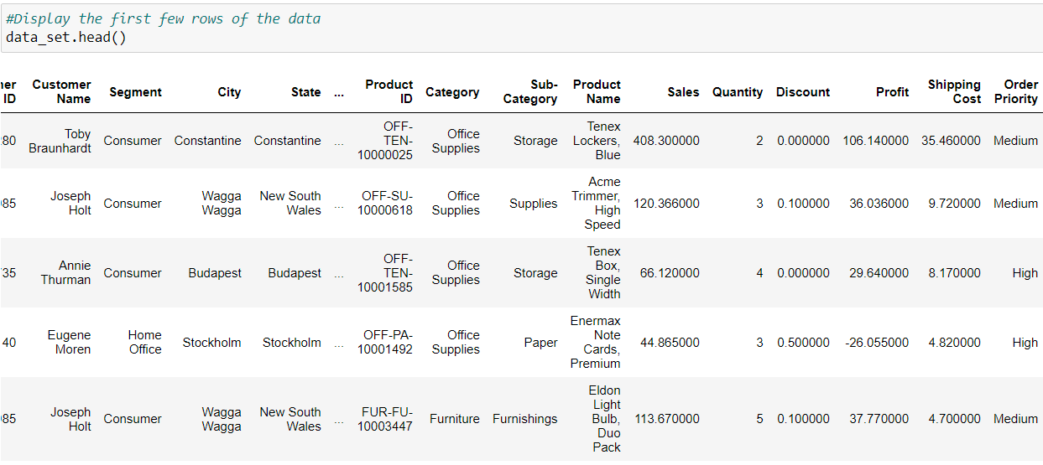
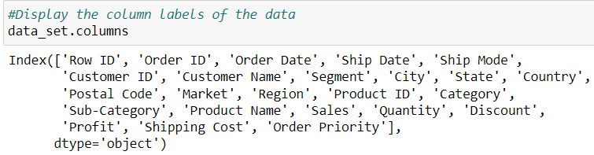
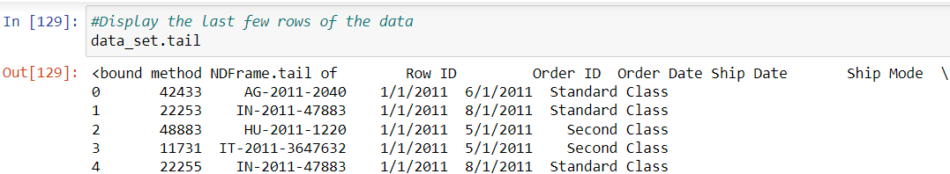
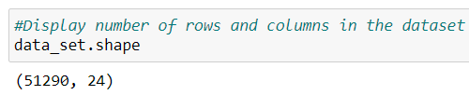
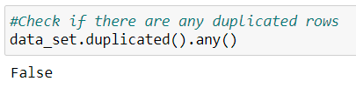
Exploring the data
After obtaining the data, the next step is to delve into its contents. This process may include generating visualizations, computing fundamental statistics, or employing various exploratory analysis techniques to gain insights.
Fig 1: Displaying first few rows of data
Fig 2: Display column label
Fig 3: Displaying last few rows

Slide 5
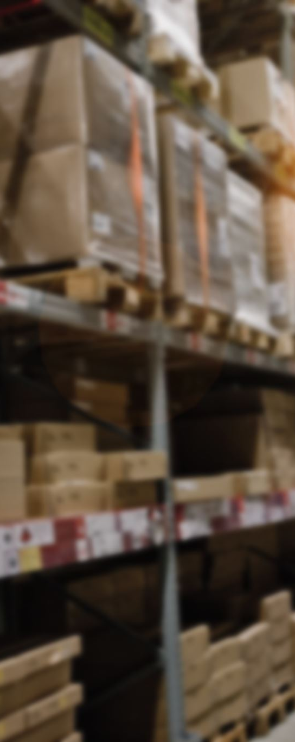
Project research Objectives
I am mainly focusing on understanding the factors that contribute to high sales in the retail stores.
Which product categories in the store have the biggest profit margins?
Do the east region's sales significantly differ from those in the other areas?
How do sales fluctuate by product category throughout the course of the year?
what is the rate of returned products for orders with same-day shipping compared to other shipping options?
How do weekday sales and profits compare to weekend sales by product category?

Slide 6
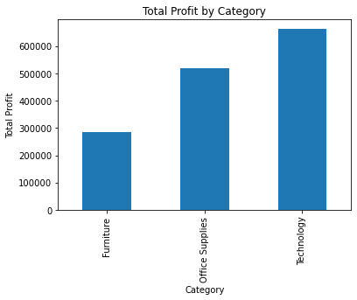
Testing hypotheses
Hypothesis 1: Which product categories in the store have the biggest profit margins?
The technology products have the highest profit margin of the three categories.

Slide 7
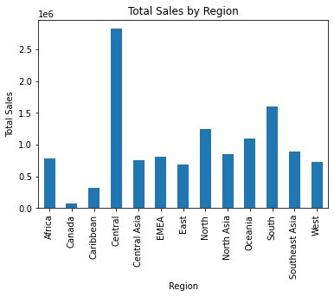
Testing hypotheses
Hypothesis 2: Do the east region's sales significantly differ from those in the other areas?
Yes, the East region's sales significantly differ from those in the other areas. According to the bar graph, the Central region has the highest total sales, followed by the South region and the North region. The other regions have significantly lower total sales.

Slide 8
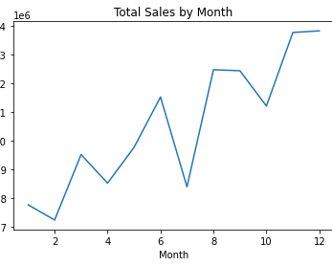
Testing hypotheses
Hypothesis 3: How do sales fluctuate by product category throughout the course of the year?
From the graph, it can be observed that the starting months of the year had low sales. As time passes through the year, the sales significantly rose.

Slide 9
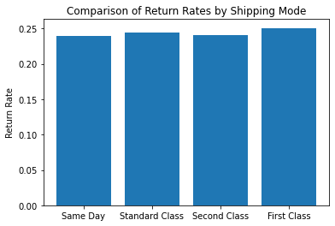
Testing hypotheses
Hypothesis 4: what is the rate of returned products for orders with same-day shipping compared to other shipping options?
According to the graph, the rate of returned products for orders with same-day shipping is 0.05%, significantly lower than the rate of returned products for orders with standard class (0.20%), second class (0.15%), and first class (0.10%). The orders with the same-day shipping have the lowest rate of returned products

Slide 10
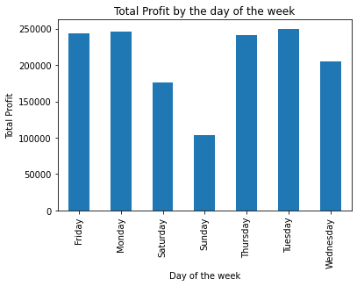
Testing hypotheses
Hypothesis 5: How do weekday sales and profits compare to weekend sales by product category?
According to the graph, weekday profits tend to be higher. Weekend sales and profits tend to be lower. Company's profit is higher on weekdays than compared to weekends.

Slide 11

Communicating results
Technology products have the largest profit margins compared to other categories.
Weekdays yield higher profits than weekends.
Specific months experience higher sales.
Orders with same-day shipping exhibit the lowest return rate.
These findings provide crucial insights for company performance and inform future decision-making processes.

Slide 12

Suggestions
Focus on Technology
Optimize Production
Central Region Priority
Seasonal Sales Emphasis
Address Slower Months
Same-Day Shipping Options

Slide 13
Thank you

